Slide 1
Queues
FIFO Data Storage

Slide 2
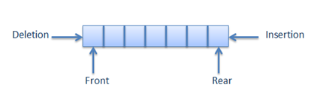
What makes a Queue?
Like a Stack, a Queue is a linear end-point sequence
Data is stored in linear sequence
Data can only be accessed at one point; the front/start
This means data cannot be searched or amended within the sequence
Data can only be added at one point; the rear/end
A Queue works as FIFO - First In, First Out
Opposite to stacks
First element to be added is the only thing you can currently access

Slide 3
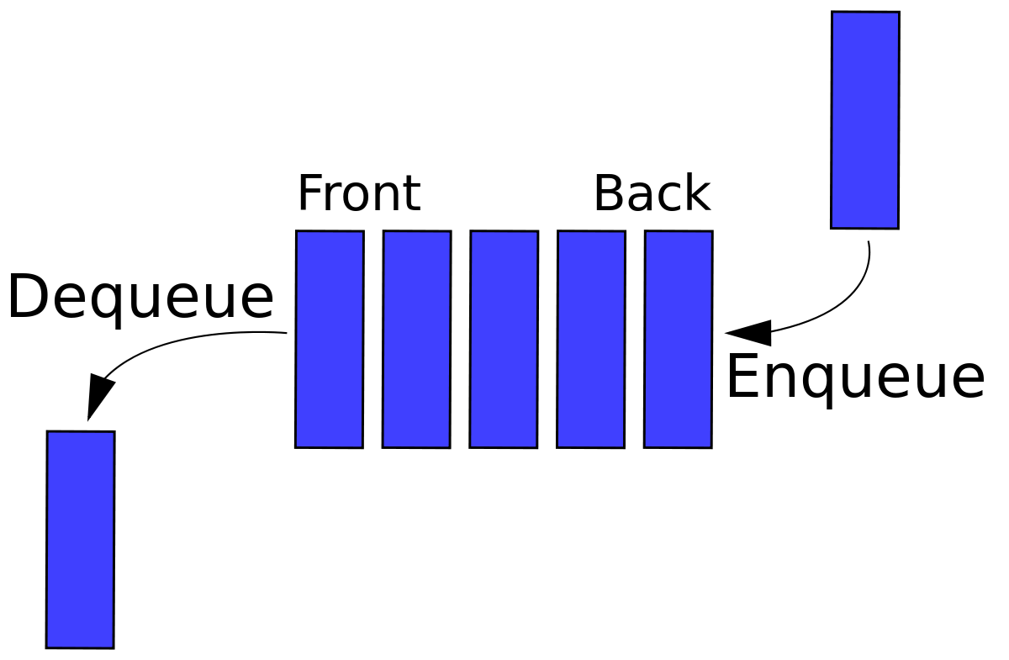
Fundamental Operations for a Queue
Queue is also a greatly reduced/restricted form of list
Queues can:
Add an element to end of the queue (enqueue)
Remove the top element from the queue (dequeue)
Check the element on top of the queue without removing it (peek)
Count elements in the queue
Check if the queue is empty
Check if the queue is full

Slide 4
Queue ADT: A More Formal Definition
enqueue(e) Insert element e at the end of the queue
Input: Element to be added
Output: None
dequeue() Remove element from front of the queue and return it. If the queue is empty, an error should occur
Input: None
Output: Element
peek() Retrieve element from front of queue and return it. This should NOT remove the element from the queue. If the queue is empty, an error should occur
Input: None
Output: Element

Slide 5
Queue ADT Continued
count() Return the number of elements in the queue
Input: None
Output: Integer
isEmpty() Return a boolean indicating if the queue is empty
Input: None
Output: True/False
isFull() Return a boolean indicating if the queue is full
Input: None
Output: True/False
Note: This is only NEEDED in a bounded queue, i.e. when implementing queues with a limit on their size

Slide 6
Queue ADT: Some Alternative Options
Queues are not as restricted as Stacks
The methods listed in the ADT are more of a starting point.
Even method names aren’t fixed!
Java even offers two versions/approaches to operations:
Safe: No chance of an exception.
Risky: Exceptions may happen – developed from the idea of failing fast

Slide 7
The Fail Fast Attitude
Fail fast: if something goes wrong, fail immediately, and fail visibly
Throw an exception, make noise (fail visibly)
Do it as soon as you can (fail immediately)
This is the same approach we’ve been taking to handling inappropriate parameters and index values outside array bounds
Check for issues with the information as soon as the method begins (failing immediately)
Throw an appropriate exception to inform the calling code what happened (failing visibly)
If you fail obviously, it is much easier to detect
Returning null where something was expected means the calling code will have to check it’s not null before trusting it exists
Throwing an exception is a very obvious sign that nothing was found

Slide 8
Safe Vs Risky
Risky methods in our ADT:
add() / enqueue() – Can throw an exception in a bounded queue if the queue is full
remove() / dequeue() – Can throw an exception if the queue is empty
peek()* - Can throw an exception if the queue is empty
Safe alternatives:
offer() – TRY to add it, and if the queue is full, return false to indicate the addition was unsuccessful
poll() – TRY to remove the first element, and if the queue is empty, return null.
Java’s risky version is element(),
peek() is safe!
Notes:
*Java’s risky version is called element(), while its safe version is called peek()

Slide 9
Implementing the Queue ADT
Arrays V.s. Linked Lists

Slide 10
Approaches to Queue Implementation
Just like Stacks, there are two main approaches to coding an implementation of a Queue ADT
Array-based
Pointer/Link-based <- we will focus on this approach!
In both cases, you must track the start and end of the queue data
Array-based:
Track the position of the last item added to the queue (the end position)
Track the position of the first item added to the queue (the start position)
Link-based:
Track the first node in the list (the start position)
Track the last node in the list (the end position)
Always add to the end of the list, i.e. connect newNode to the tail/last node

Slide 11
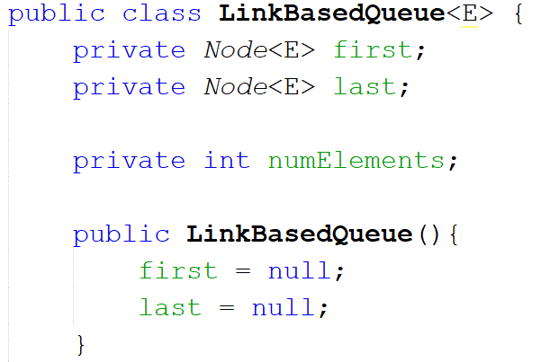
Link-based Implementation
Required:
A Node to store the first element in the queue
A Node to store the last element in the queue
A count of the number of elements in the queue

Slide 12
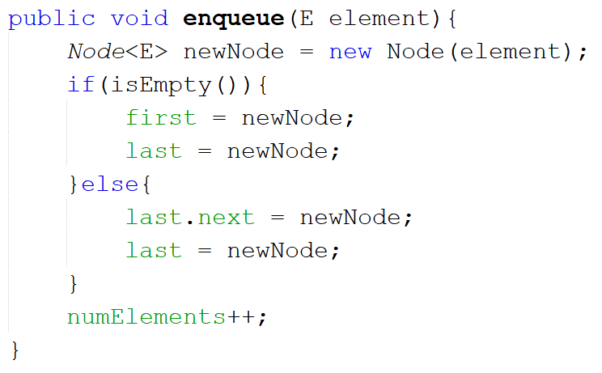
Adding to a Link-Based Queue
When enqueueing:
Create Node to store new element
Check queue is not empty
If it is, add new node as both first and last elements in queue
If it’s not:
Point next pointer within current last element to the new node
Set last element to point to new node
Increase element count by one

Slide 13
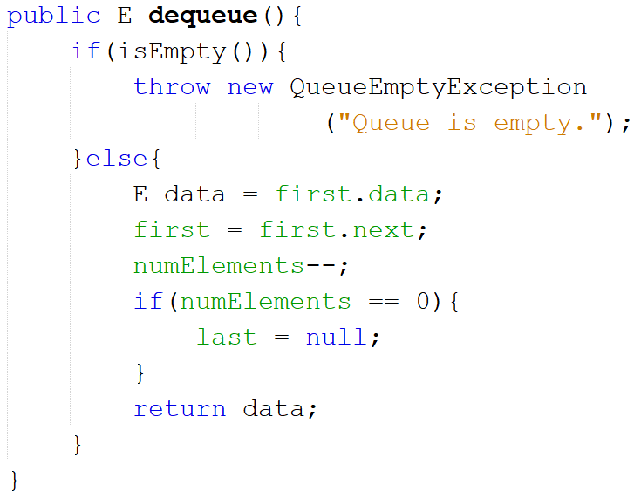
Removing From a Link-Based Queue
When dequeueing:
Check there is an element in the queue
If there isn’t, throw a NoSuchElementException, or a QueueEmptyException*
If there is:
Copy data in first element to temp variable
Set first pointer to point to next element in the queue
Decrease element count by one
Check if there is anything left in the queue
If it’s empty, set last to null
Return temp variable
Notes:
* QueueEmptyException is a custom exception class. The NoSuchElementException is from Java’s exceptions library and would be equally useful (and doesn’t require writing an extra class)

Slide 14
Priority Queues
Priority queues are queues with a twist - all elements are added in order of priority
Works based on Comparable and Comparator interfaces
Enqueueing an element should:
Check if the first element has lower priority
If so, insert in front of first element
If not, check if last element has higher priority
If so, insert after last element
If not, start at start of queue and:
Check if the element in the queue has higher priority than element to be added
If it does, move the element after this
Continue until you find an element with a lower priority
Insert between that one and its next node
How can we tell which has higher/lower priority??

